Slide 1
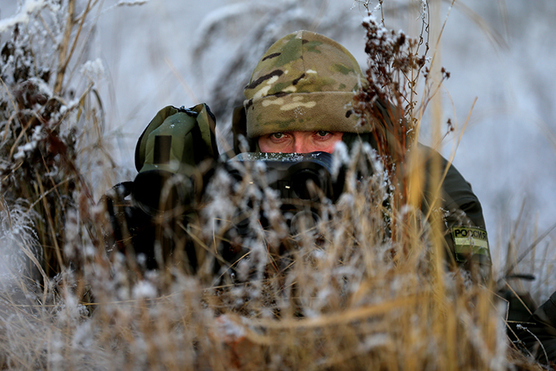
Military Target and Equipment detection using Computer Vision
Under the Guidance of
Prof.
Dept. of CSE
Prof.
HOD
Project By:
Suhas S

Slide 2
AGENDA
AGENDA
Abstract
Introduction
Literature Survey
Existing System
Proposed System
System Design
System Implementation
System Requirement Specifications
Conclusion
Future Scope
References
Abstract
Introduction
Literature Survey
Aim and Objective
Existing System
Proposed System
System Requirement Specifications
References

Slide 3
Abstract
Military target detection technology is the foundation and key to perceive and analyze the battlefield situation.
We are proposing the novel approach for automatic detection of military targets in complex environment through deep learning.
Military target dataset composed of armed men with different weapons
we improved the components of YOLOv3 and proposed a military target detection algorithm (YOLO- 7).

Slide 4
Introduction
Military target detection belongs to the basic technology in the military field.
Battlefield situation is highly dynamic, the detection speed of military equipment is required to ensure that the real-time detection of targets.
YOLO7, as an excellent detector to detect the military targets.
In this an intricate yet comprehensive solution, encompassing leading-edge technologies such as the YOLOv7 (You Only Look Once version 7) object detection framework, PyTorch, OpenCV, and Flask, culminating in a web-based application tailored for real-time military target and equipment detection.

Slide 5
Literature Survey
Sl No | TITLE | DESCRIPTION
1 | YOLOv3: An Incremental Improvement (2018) | YOLOv3, Bounding Box Prediction, Class Prediction. Here, describe the working and performance of YOLO v3 Model.
2 | Battlefield Image Situational Awareness Application Based on Deep Learning(2019) | Deep learning, Convolution neural network, Situational awareness. Model speed and accuracy of target detection is average (62%).
3 | An Anchor-Free Detection Method for Ship Targets in High-Resolution SAR Images (2021) | Category-position (CP), fully convolutional onestage object detection (FCOS), high-resolution (HR), ship detection, synthetic aperture radar (SAR)

Slide 6
Literature Survey
Sl No | TITLE | DESCRIPTION
4 | An improved one-stage pedestrian detection method based on multi-scale attention feature extraction(2021) | one-stage object detection, pedestrian detection, bounding box regression. Introduces convolutional neural network-based pedestrian detection method.
5 | YOLO-G: A Lightweight Network Model for Improving the Performance of Military Targets Detection (2022) | In this paper, they will explain about Ghost Net Model(YOLO G) with baseline achieved upon YOLO3 Model.

Slide 7
Aim
The aim of this project is to identify military targets and equipment accurately and efficiently by Computer Vision.

Slide 8
Objectives
Objective
Data Collection : Military target dataset
Data Preprocessing & Feature Extraction.
Splitting the dataset
Building the Model using Computer vision
Website Development to demonstrate the result.

Slide 9
Existing System
Segmentation for target detection in complex background, and applied it to military reconnaissance related fields.
Target detection and classification using fuzzy inference system.
Automatic Target Detection (ATD) algorithm for Charge Coupled Device (CCD) images.
Automatic target recognition in Synthetic Aperture Radar (SAR) aerial images by using neural network

Slide 10
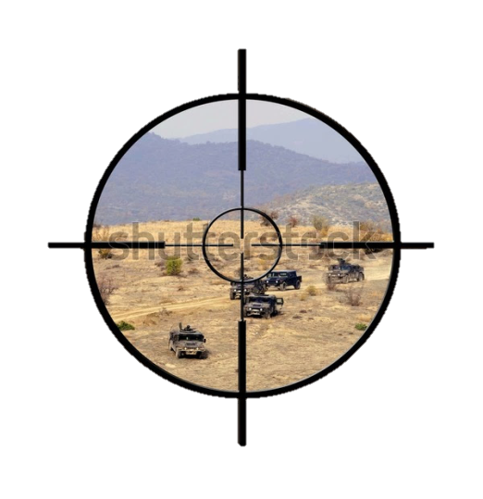
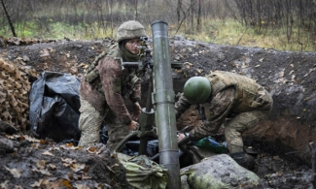
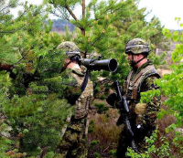
Proposed System
Military
Image Dataset
Computer Vision YOLOv7
Start
Data
Data Collection
Train
Test
Model Deployment using YOLOv7
Image
Data Preprocessing
FEATURE EXTRACTION NETWORK
Model Evaluation
End
Detection: Military Equipment

Slide 11
System Design
Architecture Diagram
Data Flow Diagram
Sequence Diagram

Slide 12
System Architecture Diagram
Military
Image Dataset
Data Pre-Processing
Model Implementation
(YOLO7)
Model Evaluation
Feature Extraction
Recognition of Object
Military Target Detection
]

Slide 13
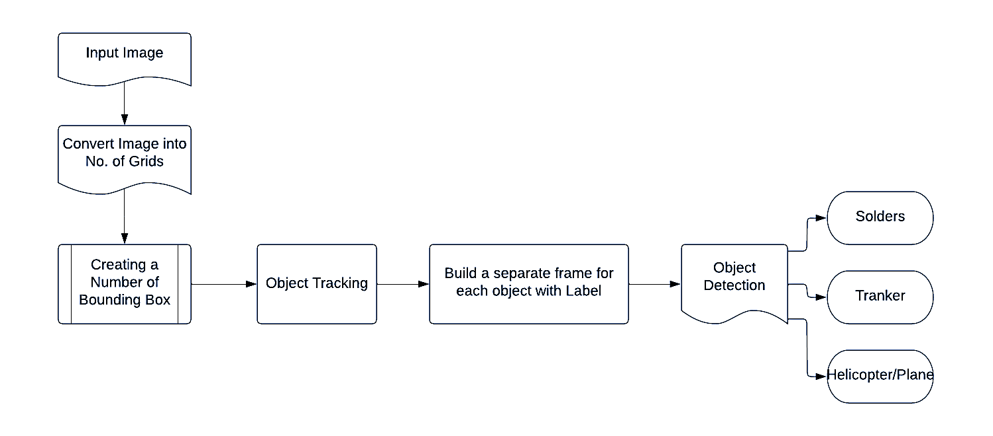
Data Flow Diagram

Slide 14
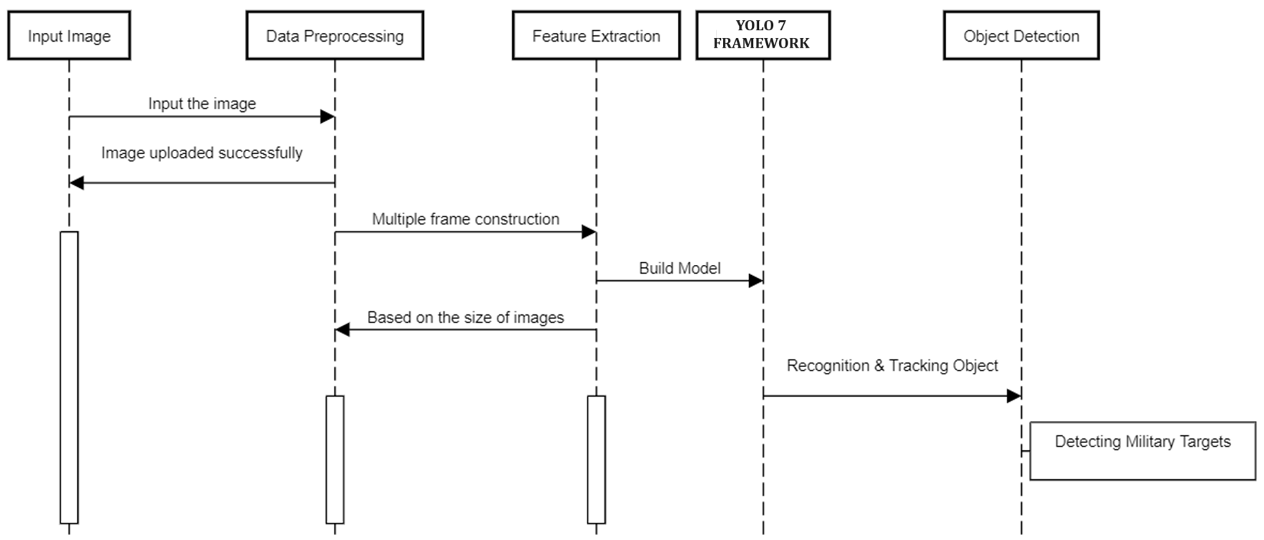
Sequence Diagram

Slide 15
Code Implementation

Slide 16
AGENDA
MODULES
Creation of custom dataset
Creation of number of classes
Generate .pt file.
Training model – Yolo v7
Testing object detector
Detection of Military Weapon
Abstract
Introduction
Literature Survey
Aim and Objective
Existing System
Proposed System
System Requirement Specifications
References

Slide 17
MODULE -1: Dataset Collection
Data Creation : In view of the above-mentioned task of military target detection in complex environment, we create customized images of different weapons used in military.
The machine learns with datasets. A dataset must contain images and labels. For example, let my goal is to create a system that detects war tanks.

Slide 18
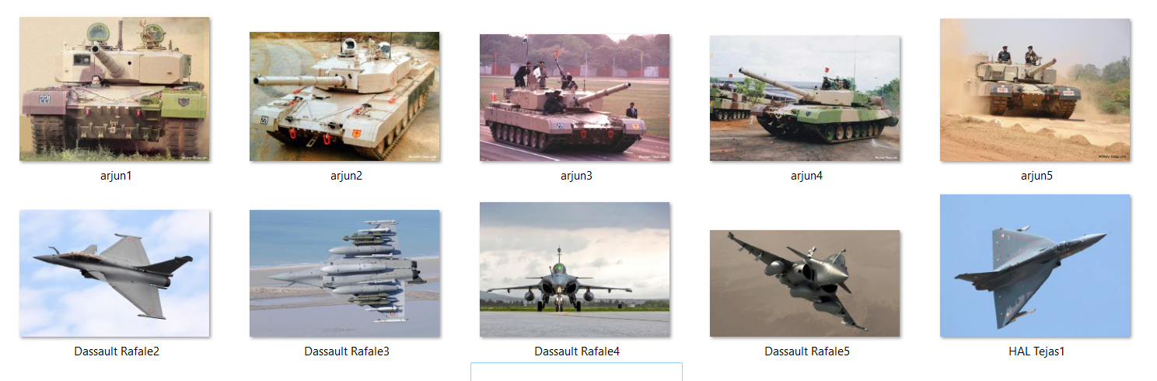
MODULE -1: Dataset Collection

Slide 19
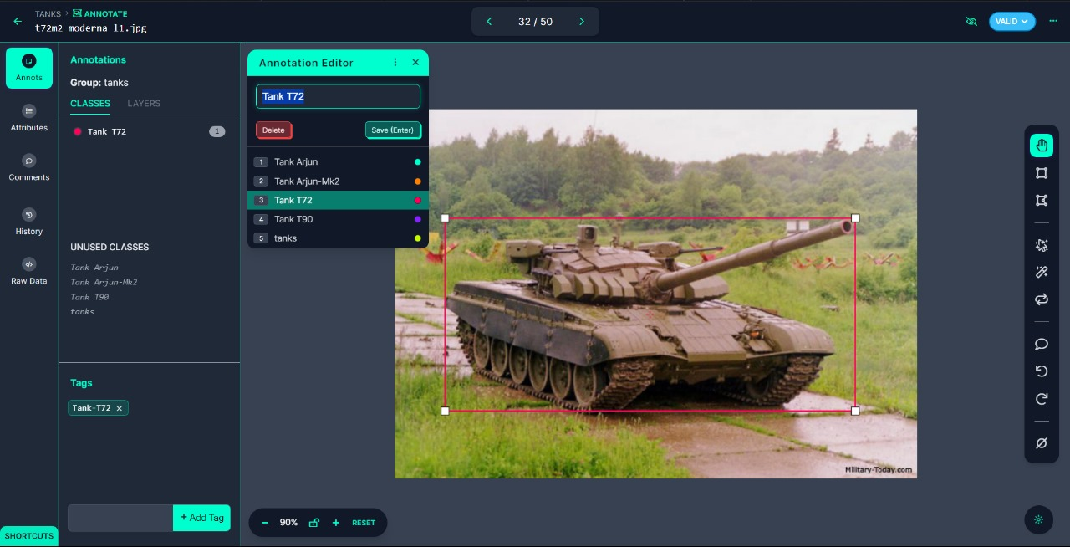
Module 2: Custom Dataset : Roboflow
Creation of number of Classes
Annotating image and defining the class

Slide 20
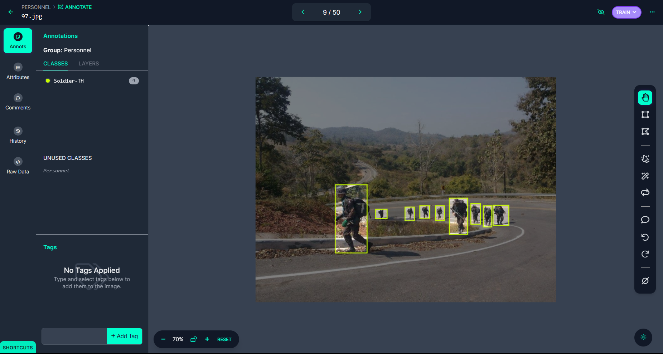
Annotated classes in an Image

Slide 21
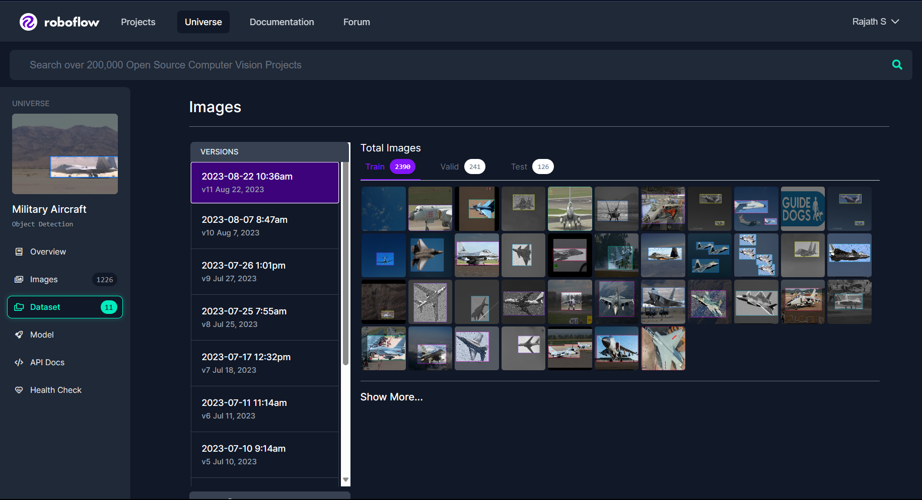
Generated Standard Dataset

Slide 22
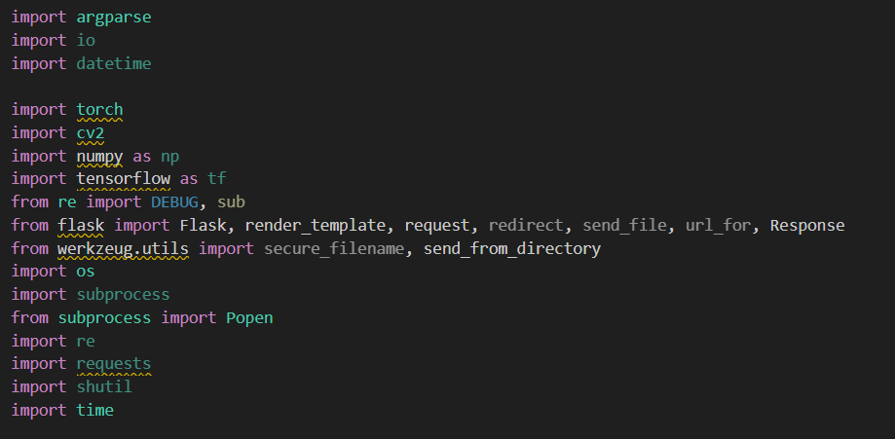
cvxvxvxv
MODULE 3 : Training Yolo V7 Model
1. Importing Packages

Slide 23
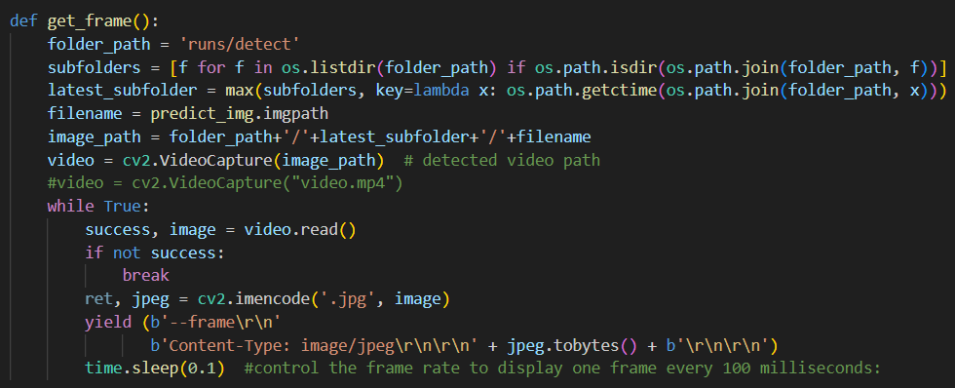
cvxvxvxv
MODULE 3 : Training Yolo V7 Model
2. Generate Frames

Slide 24
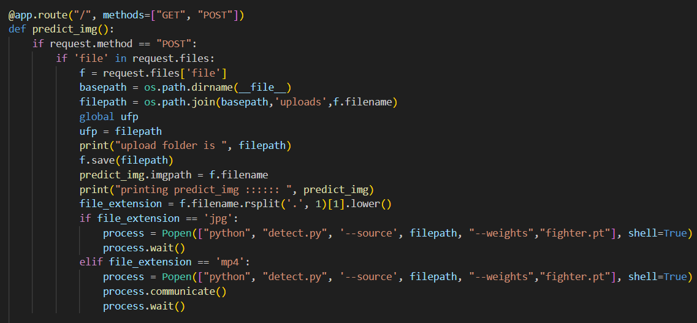
cvxvxvxv
MODULE 3 : Training Yolo V7 Model
3. Image Prediction

Slide 25
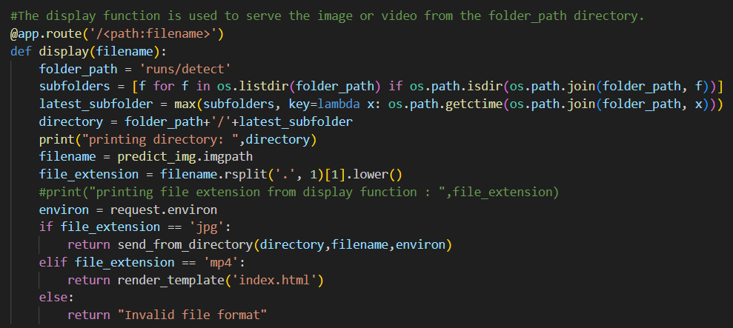
cvxvxvxv
MODULE 3 : Training Yolo V7 Model
4. Display detected images

Slide 26
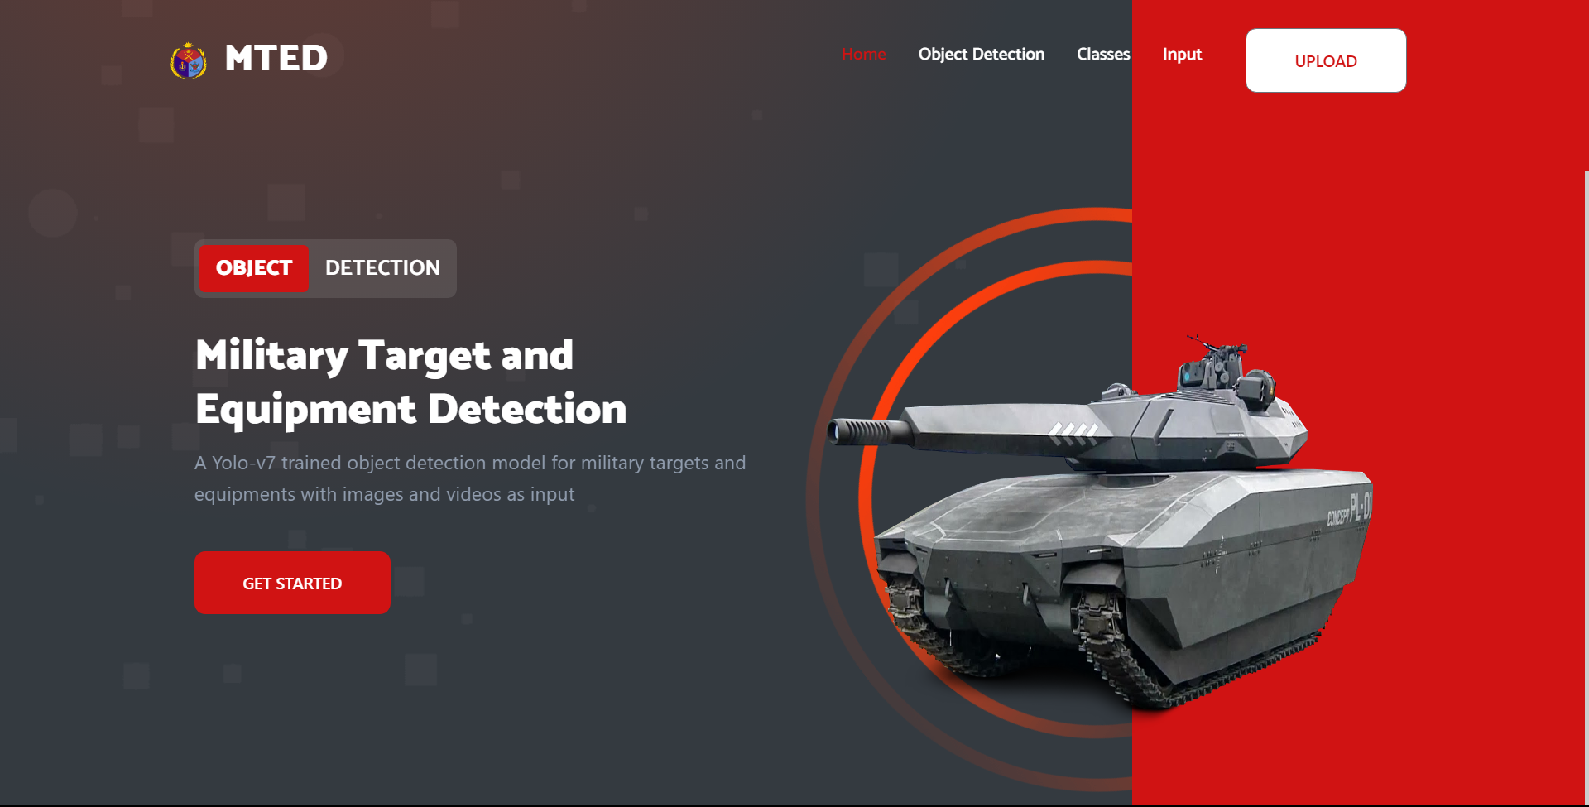
Web Application
Home Page

Slide 27
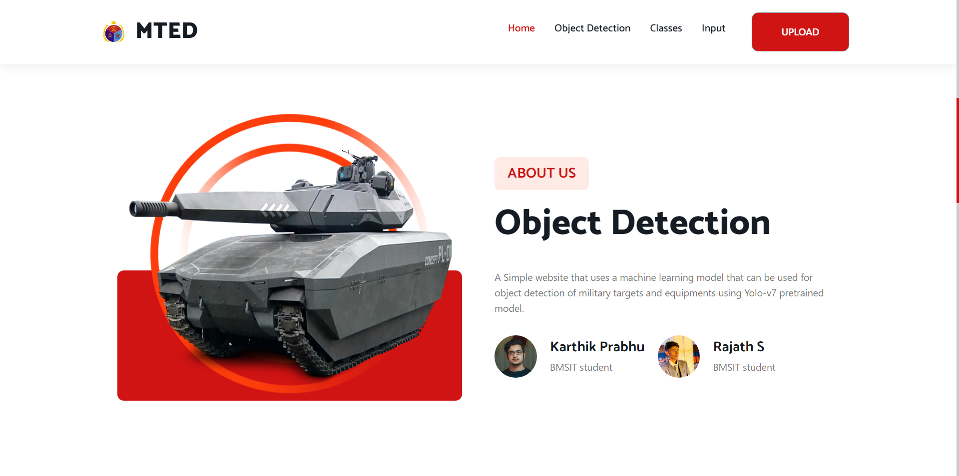
ABOUT US: OBJECT DETECTION

Slide 28
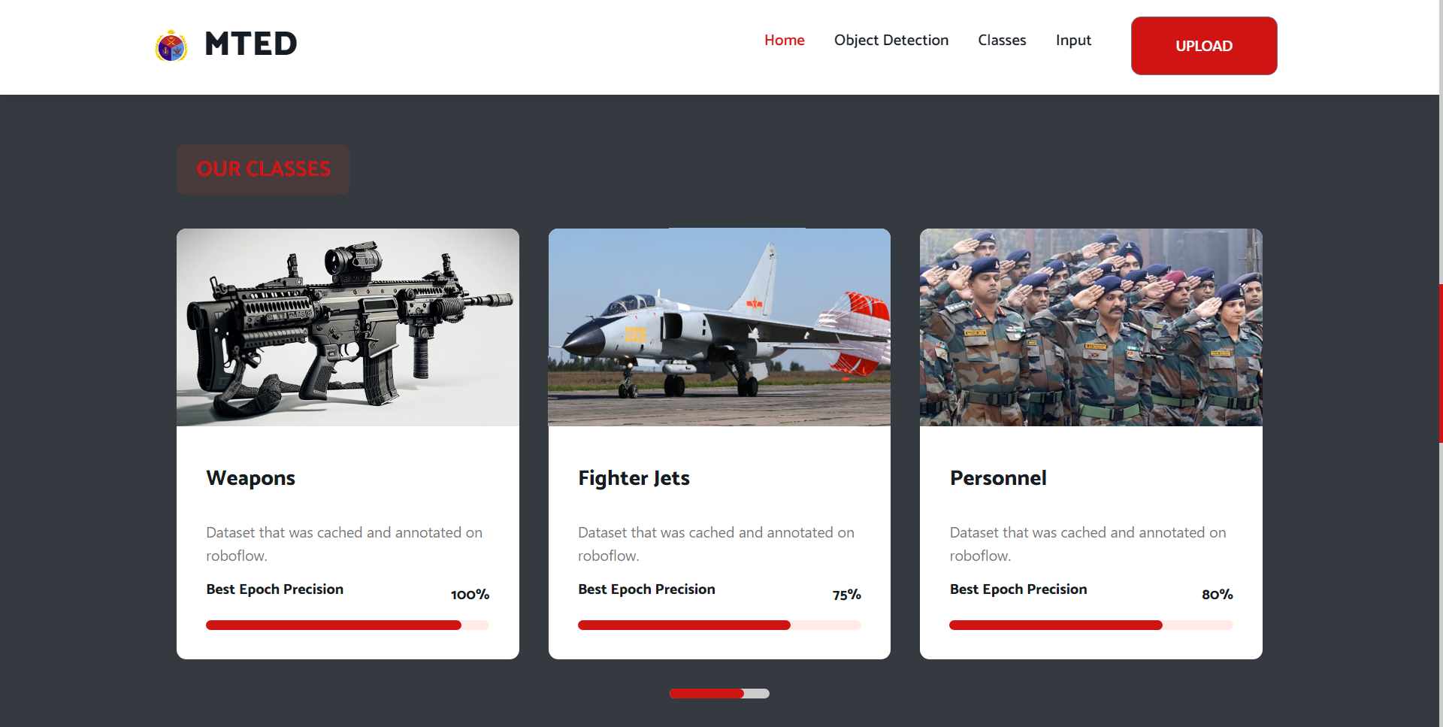
CLASSES

Slide 29
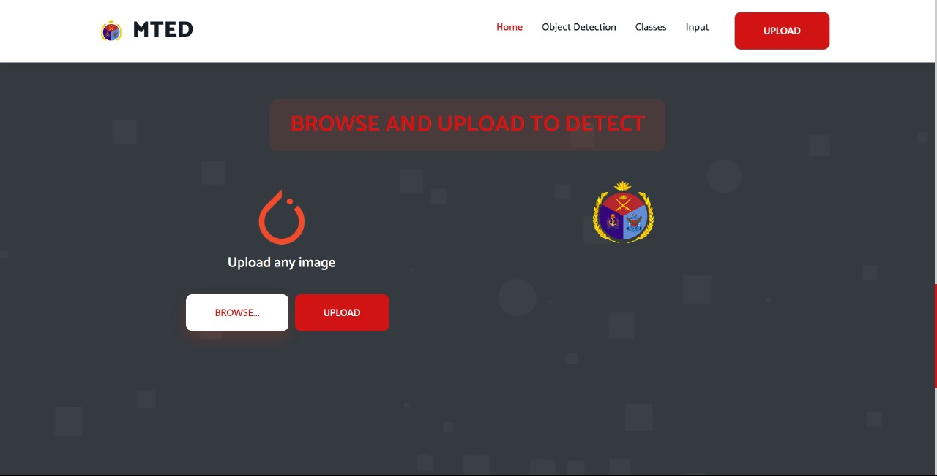
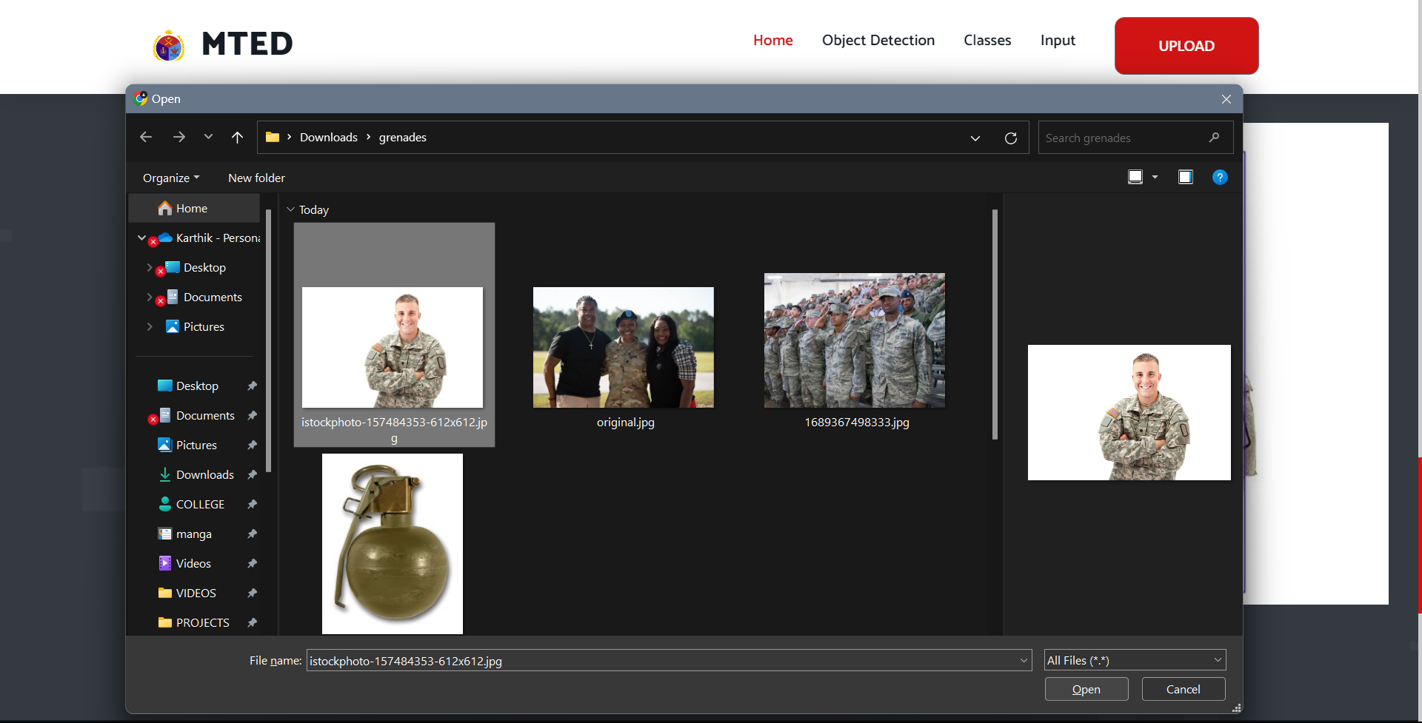
UPLOAD IMAGES

Slide 30
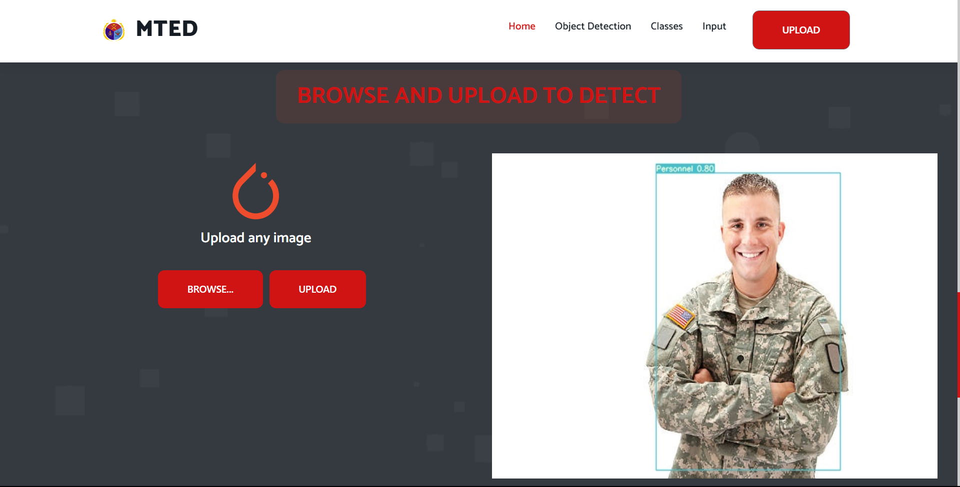
RESULT – DETECTED IMAGE

Slide 31
System Requirement Specifications
Software Requirements
Scripting language: Python Programming
Scripting Tool: Anaconda Navigator (Jupyter Notebook)
Operating System: Microsoft Windows 8 /10 or 11
Dataset: Military Dataset
YOLO object Detection with NVDIA Cuda GPU
Hardware Requirements
Processor : 3.0 GHz and Above
Output Devices : Monitor (LCD)
Input Devices : Keyboard
Hard Disk : 1 TB
RAM : 8GB or Above

Slide 32
CONCLUSION
In summary, this research project has yielded a robust computer vision system
for military target and equipment detection.
Leveraging the YOLOv7 framework, pytorch, OpenCV, and Flask,
we have created a versatile and user-friendly application.
Notably, the ability to adjust the confidence threshold enhances precision customization,
while support for real-time webcam and RTSP stream processing extends its utility.
This project bridges the gap between theory and practicality, equipping military and
security personnel with a powerful tool to enhance operational efficiency
and situational awareness. Its adaptability, precision, and
security measures position it as a valuable asset in the defense and security
domain, addressing critical needs in target identification and tactical decision-making.

Slide 33
Future Scope
Dynamic Confidence Threshold Adjustment
Integration of Webcam and RTSP Stream Support
Class Identification and Confidence Reporting:

Slide 34
References
[1] M. Everingham, L. Van Gool, An Incremental Improvement 2018
[2] H. Peng, Y. Zhang, S. Yang, And B. Song, ``Battlefield Image Situational Awareness Application Based On Deep Learning,'' IEEE Intell. Syst., Vol. 35, No. 1, Pp. 36_43, Jan. 2020.
[3] Zhongzhen Sun , Muchen Dai, Xiangguang Leng , Member, Ieee, Yu Lei, Boli Xiong, An Anchor-free Detection Method For Ship Targets In High-resolution Sar Images, Ieee Journal Of Selected Topics In Applied Earth Observations And Remote Sensing, Vol. 14, 2021
[4] Xiaoru Song, Song Gao *, Chaobo Chen “An Improved One-stage Pedestrian Detection Method Based On Multi-scale Attention Feature Extraction” Ieee Transactions On Journal 2021
[5] LINGREN KONG 1, JIANZHONG WANG 1, AND PENG ZHAO 2, “YOLO-G: A Lightweight Network Model For Improving The Performance Of Military Targets Detection” IEEE ACCESS (2022)
[6] A. K. Jain, N. K. Ratha, And S. Lakshmanan, ``Object Detection Using Gaborlters,'' Pattern Recognit., Vol. 30, No. 2, Pp. 295_309, 1997.

Slide 35


